Slide 1


Bird Scouts
Aditya
Krishna
Nagasai
Sanyat
Sathvik
Shankaradithyaa
- Team 6
Notes:
shankar

Slide 2
Project Objective
Data Collection
Audio Pipeline
Image Pipeline
Chatbot & other features
Notes:
shankar

Slide 3
Project Objective
To develop a user-friendly web application that leverages machine learning to accurately identify bird species from audio recordings and images. Bird Scouts aims to:
Facilitate quick and reliable bird identification for researchers, birdwatchers, and nature enthusiasts.
Enhance understanding of bird species through automated analysis of vocalizations and visual features.
Notes:
nagasai

Slide 4
Customer Needs Assessment
Conducted feedback sessions with fellow birdwatching enthusiasts in our batch.
Key desired features for an AI-assisted bird identification platform:
Species detection from both bird images and audio recordings.
Ability to identify bird species using bird feathers found on the ground to help determine the bird population in specific areas.
Optional feature to identify trees based on leaves or trunk, enhancing knowledge of the birds’ habitat.
Notes:
nagasai

Slide 5
DEMO
Repo Github link
Notes:
nagasai

Slide 6
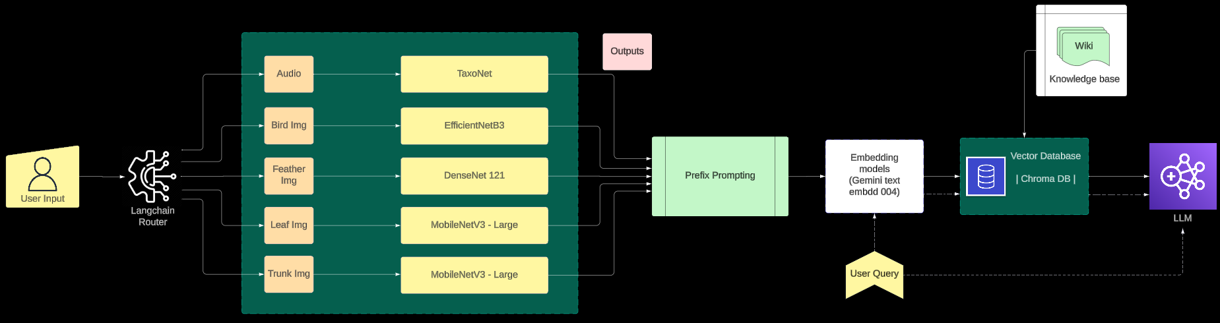
Inference Pipeline
Notes:
nagasai

Slide 7
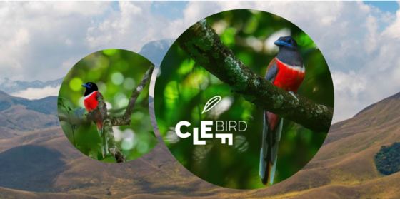
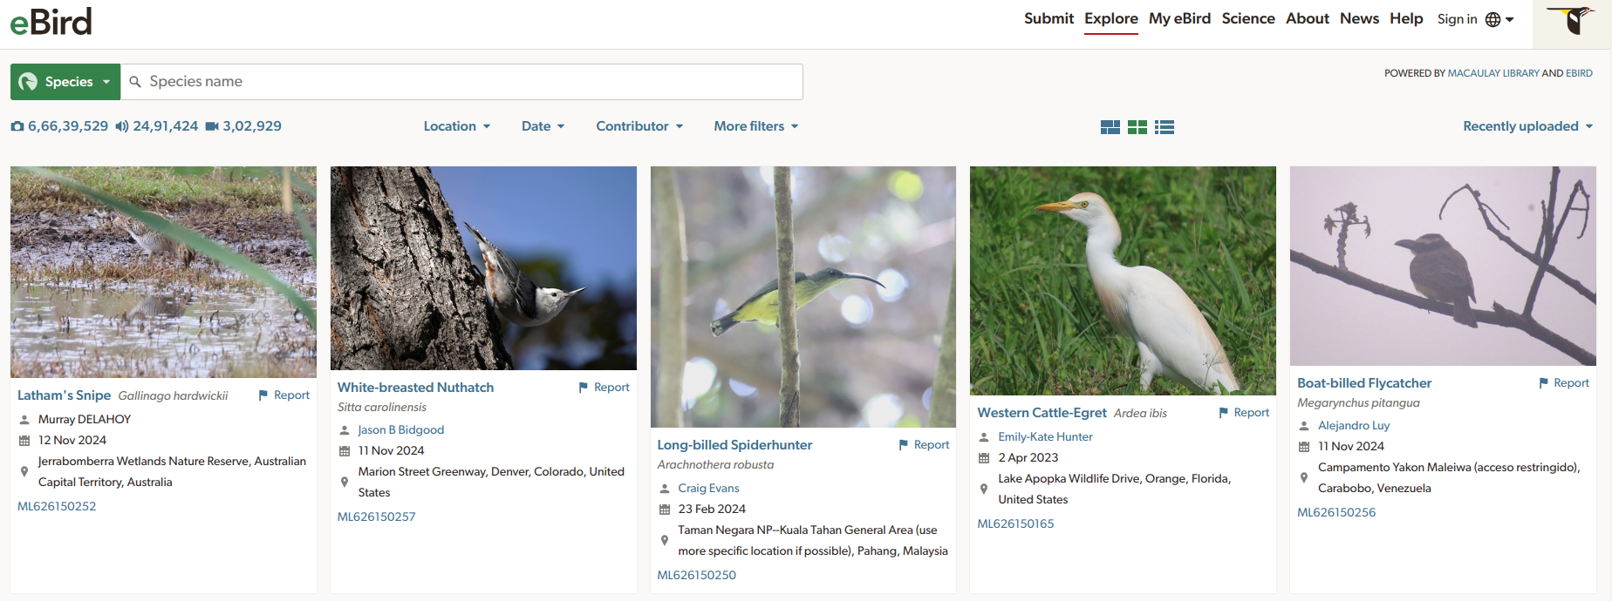
Data Collection
01
BirdCLEF 2024 competition dataset (aud)
02
eBird library by Cornell lab of Ornithology
03
25 Indian Bird Species (img)
04
Feather V1
Notes:
krishna

Slide 8
Audio pipeline
Input to ML model ?
Data Augmentation
Species Identification
Type of Call Identification
Notes:
sathvik

Slide 9
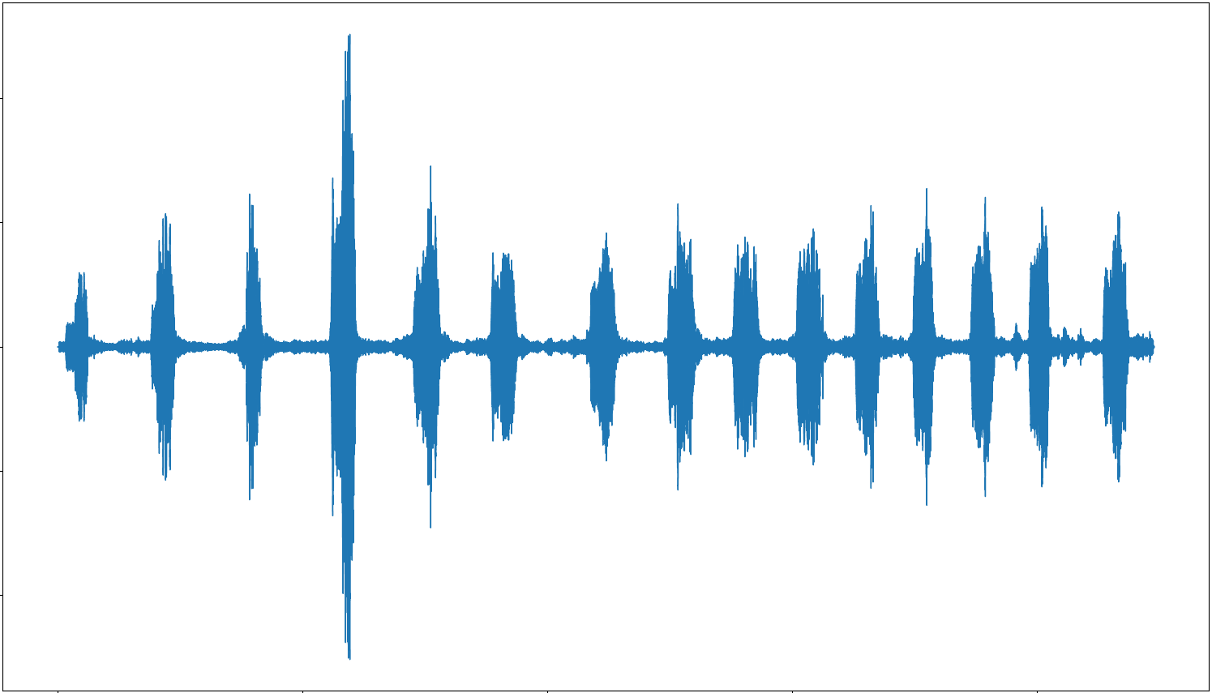
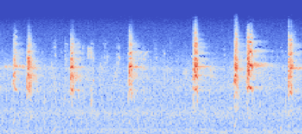
Mel Spectrogram
‘Mel Spectrogram’ is a 2D representation (freq vs time) of audio signals in the frequency domain using ‘mel scale’ to emphasize frequencies that are more perceptible to human hearing.
It’s created by applying short-time Fourier transform (STFT) on an audio signal and mapping the frequency components to the Mel scale.
Raw audio
Mel spectrogram
Notes:
sahvik

Slide 10
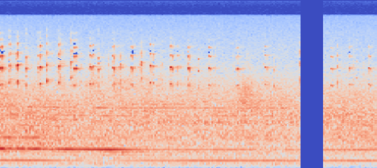
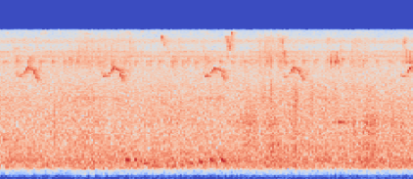
Data Augmentation
f
Time stretch
Alters speed of audio without changing the pitch
Time masking
Randomly masks a short time segment in the audio
Frequency masking
Randomly masks a range of frequencies
t
f
Time masking
t
Frequency masking
Notes:
sahvik

Slide 11
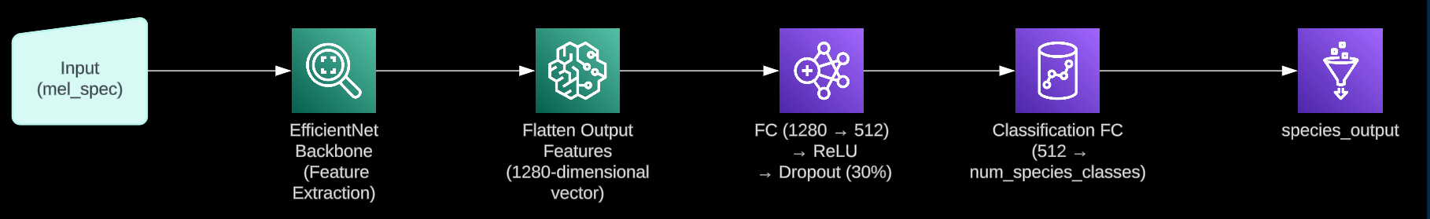
Simple model . . .
Species Identification
Using EfficientNet_v2_s as the backbone for feature extraction, with gradual unfreezing of layers implemented to prevent ‘Catastrophic Unlearning’.
Notes:
sahvik

Slide 12
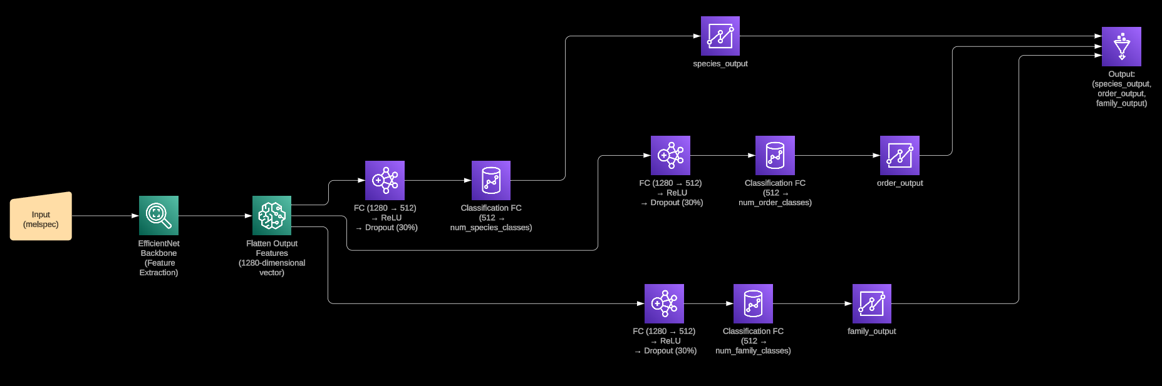
Multitask Learning
We have labels of the taxonomy (order, family, species) in our dataset
As the 3 tasks are related, why not predict all the 3 labels using separate fully connected layers at the end for each task . . . ?
Notes:
sahvik

Slide 13
Conflicting Gradients . . . Under Optimization . . .
We use Fast Adaptive Multitask Optimization (FAMO)
It adjusts the importance (by adjusting weights) of each task during training depending on how well each task’s loss is progressing.
Notes:
sahvik

Slide 14
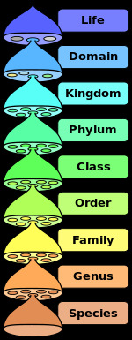
Hierarchy . . .
The hierarchy is the order, family and species taxa
Our taxonomy:
Coarse level - Order
Medium level - Family
Fine level - Species
Notes:
sahvik

Slide 15
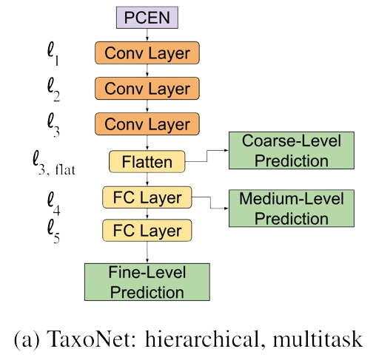
TaxoNet - Hierarchical Multitask learning
melspec
l₁
l₂
l₃
In single-task models, only l₅ contains output nodes. But in this Hierarchical Multitask learning model, l_{3,flat} is associated with coarse-level prediction(order), l₄ to the medium-level(family) and l₅ for the fine-level prediction(species).
Nodes at each layer are partitioned, with each partition mapping to a member of the current taxonomic level
Partitions for a taxa member in the current layer only connect to partitions corresponding to descendents in the next taxonomic level, mirroring the structure of the taxonomy
l_{3,flat}
l₄
l₅
Galliformes
. . .
Columbiformes
. . .
asbfly
ashdro1
yebbul3
zitcis1
Notes:
sahvik

Slide 16
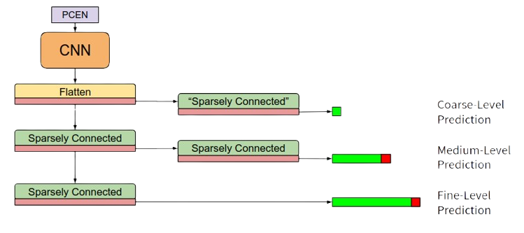
In our case . . .
melspec
Used pretrained Efficientnet_v2_s
Coarse-level prediction
Medium-level prediction
Fine-level prediction
Notes:
sahvik

Slide 17
Comparison
Model | Validation accuracies (species)
ConvModel | 68%
MTL | 70%
TaxoNet | 73%
Notes:
sahvik

Slide 18
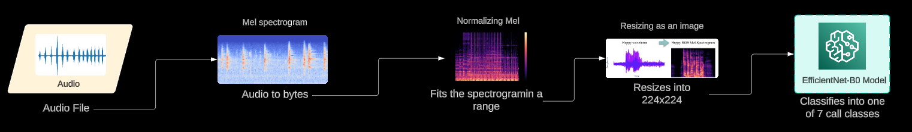
Type of sound identification
Notes:
shankar

Slide 19
Image Pipeline :- Part 1
Resnet - 50
Resize (240 x 40)
Convert to Tensor
Normalize
EfficientNetB3
Feather Class
Feather image
1 / 50
Input Image File
Image Classifier
Bird image
1 / 25
DenseNet121
Bird Class
Resize (240 x 40)
Convert to Tensor
Normalize
MobileNet - V3
Notes:
aditya

Slide 20
Training
Data
80%
20%
Train set
Test set
Data Augmentations
Random Horizontal Flip
Random Rotation upto 10*
Random Resized Crop
Color Jitter
Data Augmentation
Train loader
Test Loader
Model
Output
Notes:
aditya

Slide 21
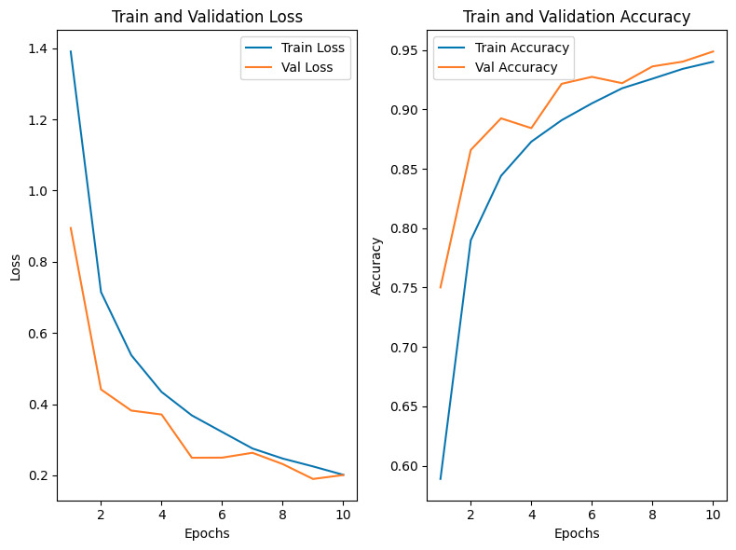
Accuracies and Plots
Model | Accuracy on Test-Set | Hyper-Parameters
EfficientNetB3 | 96.4 95.88(FeatherV1) | Batch Size = 8 Lr = 0.001 Epochs = 10
DenseNet 121 | 94.54 | Batch Size = 8 Lr = 0.001 Epochs = 10
Resnet 50 | 87 | Batch Size = 32 Lr = 0.001 Epochs = 15
MobileNet V3 | 83 | Batch Size = 32 Lr = 0.001 Epochs = 10
EfficientNetB3 on 25 Indian Bird Species
* Accuracies are for Indian 25 bird Species Dataset, unless mentioned otherwise .
Notes:
aditya

Slide 22
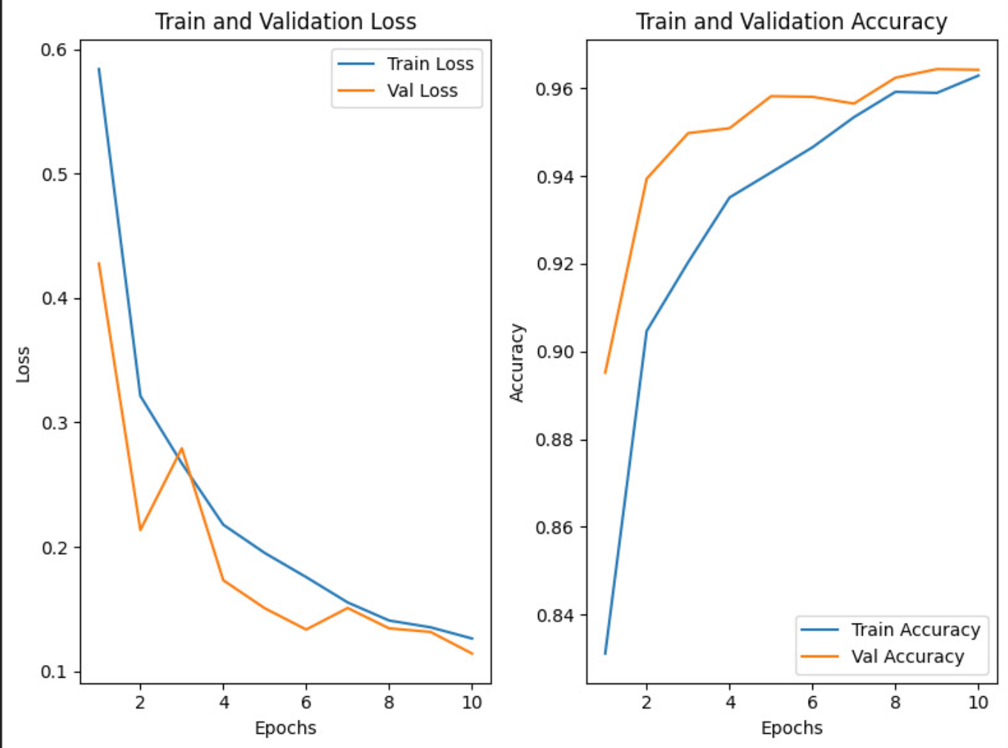
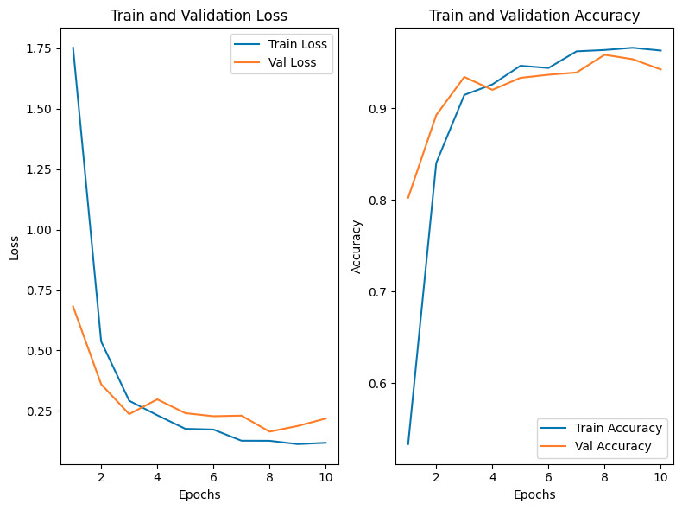
More plots
DenseNet121 on 25 Indian Bird Species
EfficientNetB3 on FeatherV1
Notes:
aditya

Slide 23
Vegetation
Species of tree identified from the input image of leaves/trunk using a MobileNet-v3 model.
We use the RAG model to query information like:
Family, Genus, Climate preference, Native Region and Associated birds
Knowing the Genus helps us identify the type of forest (Deciduous/Coniferous/etc) the tree might be surrounded by.
Depending upon this we can figure out the average climate the region endures
Many birds prefer only specific trees for nesting (eg: Woodpecker prefer Aspen wood or similar softwood trees).
Birdwatchers actively look for cues like these in their surroundings!

Slide 24
Image Pipeline :- Part 2
Resnet - 50
Resize (240 x 40)
Convert to Tensor
Normalize
EfficientNetB3
Trunk Class
Trunk image
1 / 29
Input Image File
Image Classifier
Leaf image
1 / 41
MobileNet - V3
Leaf Class
Resize (240 x 40)
Convert to Tensor
Normalize
Notes:
aditya

Slide 25
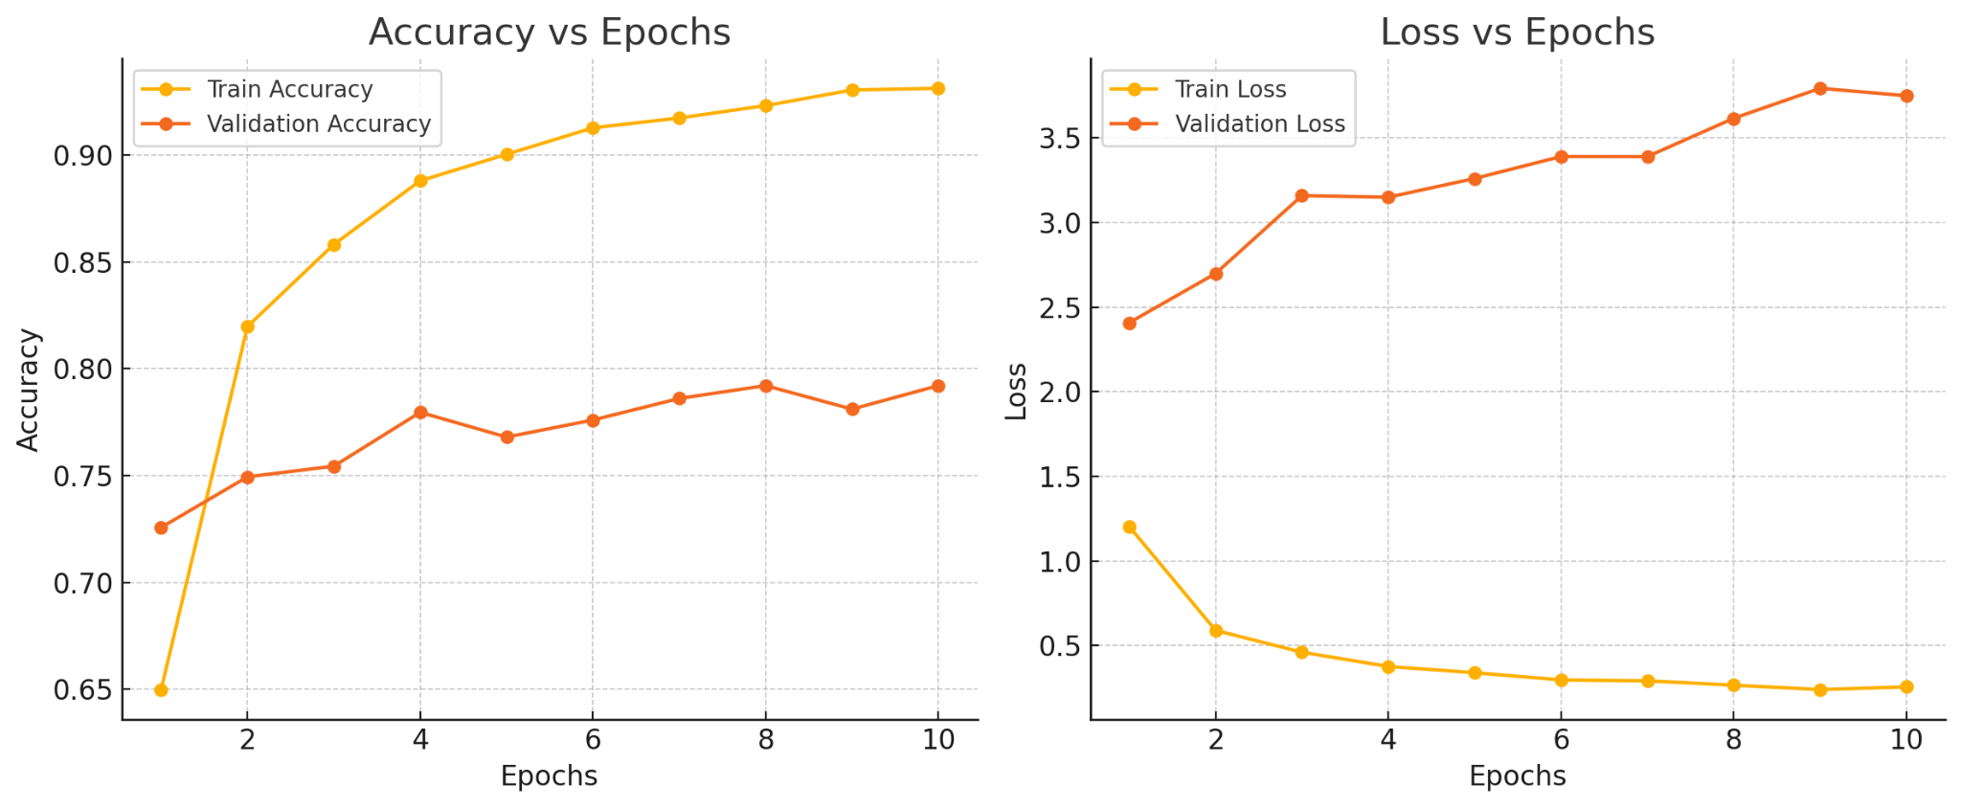
Accuracy plots:
MobileNetv3 on Leaf dataset

Slide 26
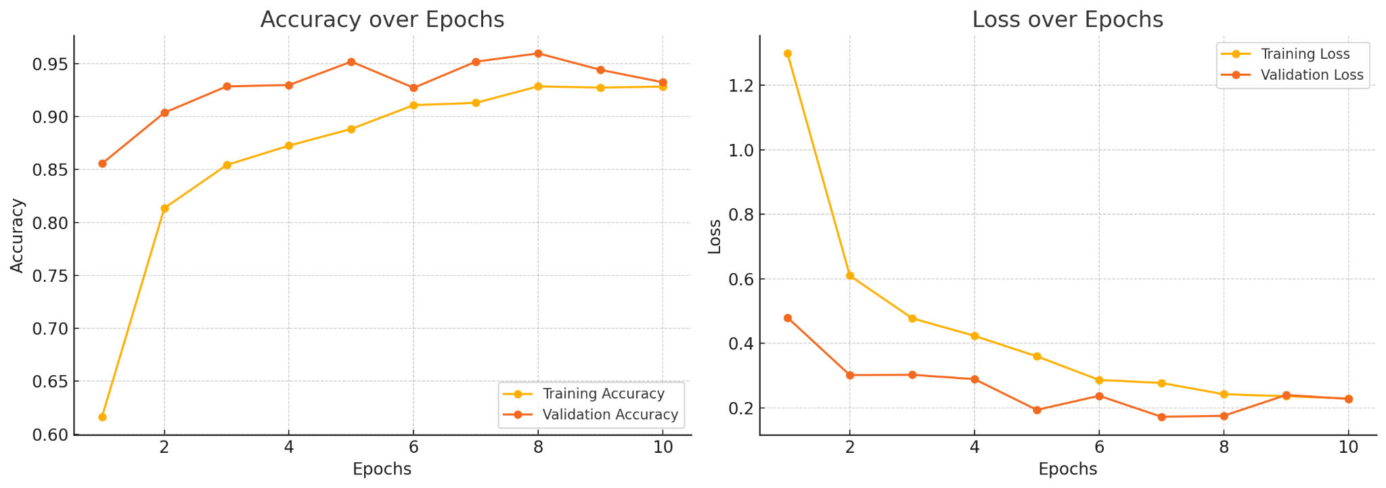
MobileNetv3 on Trunk dataset

Slide 27
Ideations for the Future
We will create a more robust login system
We will make location pinning of birds more user friendly
We will create a community of all the people who use the app
We will encourage users to enhance online databases through our app
We will create a dataset on bird excreta to further develop ml models
In future we will use a more standard tech stack
Notes:
shankar

Slide 28
Contributions
Member | Contribution
Nagasai | MBackend, Website-Logic, LLM, RAG
Sathvik | Species identifier with audio, Flowcharts
Shankar | Type of sound identifier, Website-UI, User-auth
Krishna | Dataset handling, Web Scraping
Aditya | Bird species identifier with bird image/ feather image
Sanyat | MTree identification with trunk/leaf images, BBox detection(RCNN)
Notes:
shankar

